Slide 1
Memento:
Learning Secrets from Process Footprints
Suman Jana and Vitaly Shmatikov
The University of Texas at Austin

Slide 2
Trends in software design
Applications rely on OS abstractions to improve their safety and reliability
“Process”
“User”
Case study: Web browsers
Fork a new
process
Fork a new
process
www.xbank.com
www.quickdate.com
OS isolation
Notes:
Not “all” ----“most” modern browsers

Slide 3
Unintended consequences
Good
Better isolation
Better reliability
Others not affected if one process crashes
Better safety
Bad
Leaks more info to concurrent processes
Topic of this talk
Notes:
Say that “this is a talk about unintended consequences”

Slide 4
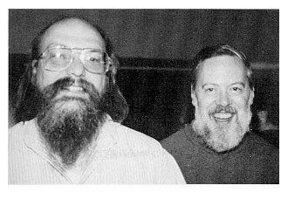
ProcFS:
Process info in multi-user OS
ps
top –p 1
cat /proc/1/status
Tom Killian
"Processes as Files" (1984)
introduced in the 1980s
Notes:
An example of this is – ProcFS, for systems that do not have procfs like freebsd there are other ways to get the same info ….procfs contains
A wealth of information memory usage, interrupt count– used by top and ps. From a privacy point of view, some of this information is pretty sensitive

Slide 5
What can one learn from ProcFS?
IP addrs of websites other users are visiting
Notes:
If use a proxy this is solved but….

Slide 6
Side channels through /proc
"Peeping Tom in the Neighborhood: Keystroke Eavesdropping on Multi-User Systems" - Usenix Security 2009
Keystroke timing leak through ESP/EIP values from /proc/<pid>/stat
Kehuan Zhang
XiaoFeng Wang
Notes:
Quick… Indiana University….stack pointer and instruction pointer…..

Slide 7
The story of "Peeping Tom"
Shout-out to
XiaoFeng ;)
NDSS '09
program committee:
"Nobody uses multi-user computers anymore"
Notes:
Sorry Xiaofeng…this is just too precious to not share

Slide 8
The story of "Peeping Tom"
Shout-out to
XiaoFeng ;)
Oakland '09
program committee:
"Nobody uses multi-user computers anymore"
Notes:
quick

Slide 9
Nobody uses multi-user computers anymore???
Notes:
pause

Slide 10
Android sandboxing = UNIX multi-user isolation
ps
top –p 1
cat /proc/1/status
UNIX multi-users in the 1980s
Notes:
Inter process api designed for people like thompson, killian power users..now it’s avlable to a diff type of “uers”….Android is an example of modern platform leveraging os-abstractions for app isolation

Slide 11
Android sandboxing = UNIX multi-user isolation
ps
top –p 1
cat /proc/1/status
Android “multi-users” in 2012

Slide 12
Android sandboxing = UNIX multi-user isolation
Different apps run as different users
Android uses OS “user” abstraction to isolate applications

Slide 13
Android sandboxing = UNIX multi-user isolation
ProcFS API is still unchanged!!
ps
top –p 1
cat /proc/1/status
Android “multi-users” in 2012
Notes:
Audio: The same API that Tom Killian designed to help Ken Thomson to debug is still available to angry birds and flying pigs

Slide 14
What can a zero-permission app do?
Can read all world-readable files in /proc
… but “Peeping Tom” attack does not work ☹
ESP/EIP too unpredictable - JVM, GUI etc.
Introducing “Memento” attacks
Works on all major OSs (except iOS)
Notes:
Access to ProcFS is not protected by any android permissions

Slide 15
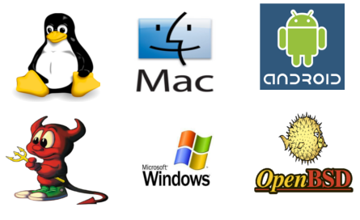
This is not just about Android!

Slide 16
Process resource usage = big-time side channel
Completely
new attack!
Memory usage leaks inputs and user actions
Reveals webpages visited in Chrome, Firefox, Android browser, any WebKit-based browser
Reveals state of Web applications
Membership in dating sites, specific interests on medical sites, etc.
CPU usage leaks keystroke timing
For bash, ssh, Android on-screen keyboard handler
Yields a better, much more robust “Peeing Tom”

Slide 17
“Memento” (2000):
putting together “memory streams”

Slide 18
“Memento” (2000):
putting together “memory streams”

Slide 19
Memprint: stream of memory usage
10568 KB
49380 KB
15976 KB
65948 KB
11632 KB
48996 KB
60280 KB
60820 KB
59548 KB

Slide 20
Sniffing memory footprints
browser
process
alloc 1
alloc 2
OS free page pool
OS isolation
2050
memprint
used page count
zero-permission
malicious process
2050
Notes:
Browser runs a separate process….Do not say info is available ‘through proc”

Slide 21
Sniffing memory footprints
browser
process
alloc 1
alloc 2
brk/mmap
OS free page pool
OS isolation
2056
memprint
used page count
zero-permission
malicious process
2050
2056
Notes:
Rendering images, building DOM tree, parsing and executing Javascripts

Slide 22
Sniffing memory footprints
browser
process
alloc 1
alloc 2
brk/mmap
OS free page pool
OS isolation
2080
memprint
used page count
zero-permission
malicious process
2050
2056
2080

Slide 23
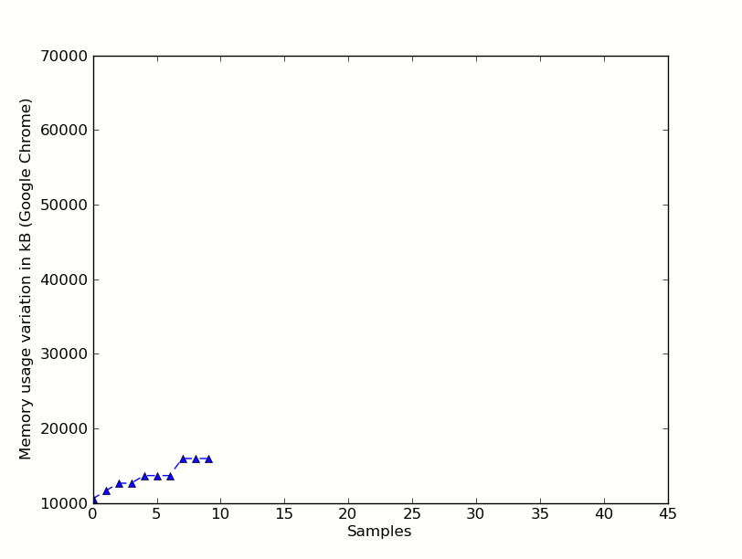
Memprint for Chrome loading benaughty.com
Notes:
For this talk I’ll refer to memprints as sequences, but in reality we used a slightly diff representation to take care of mild non-deterministic execution

Slide 24
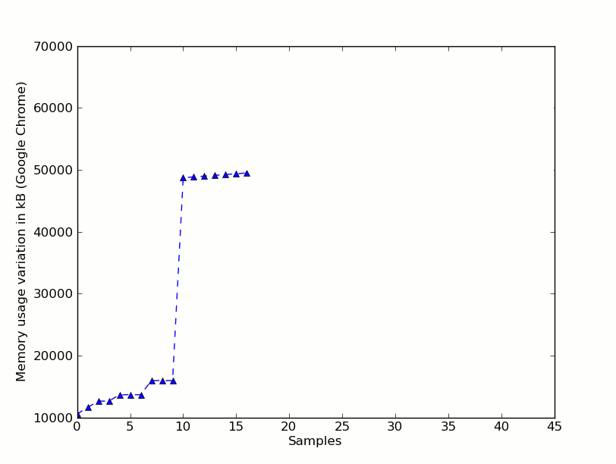
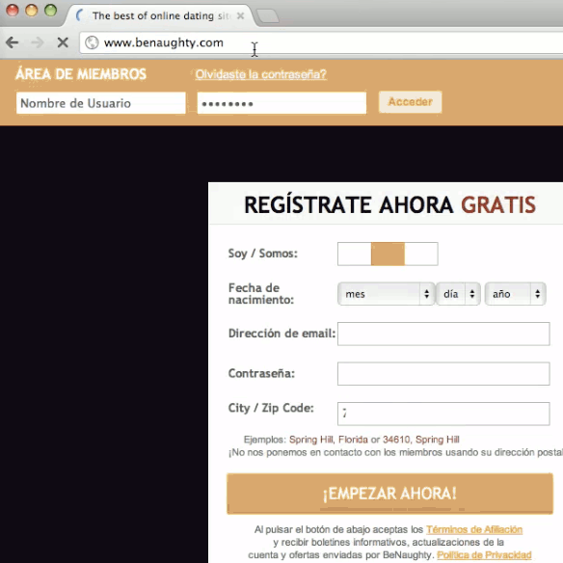
Memprint for Chrome loading benaughty.com

Slide 25
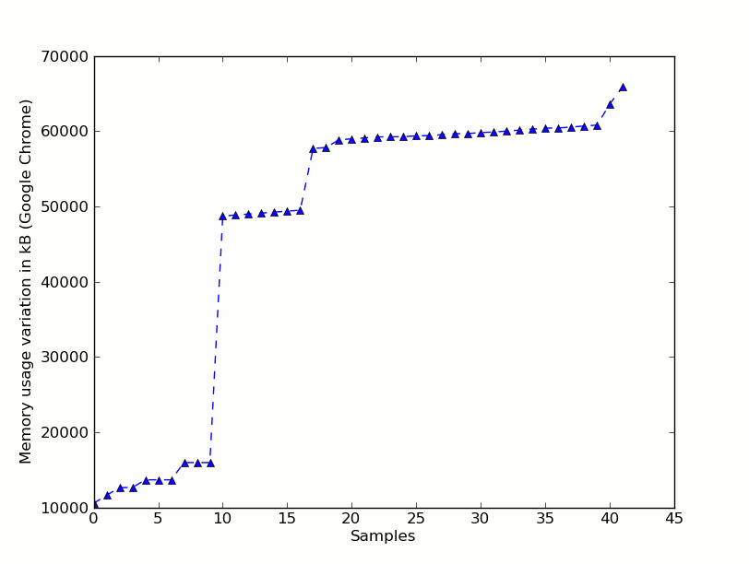
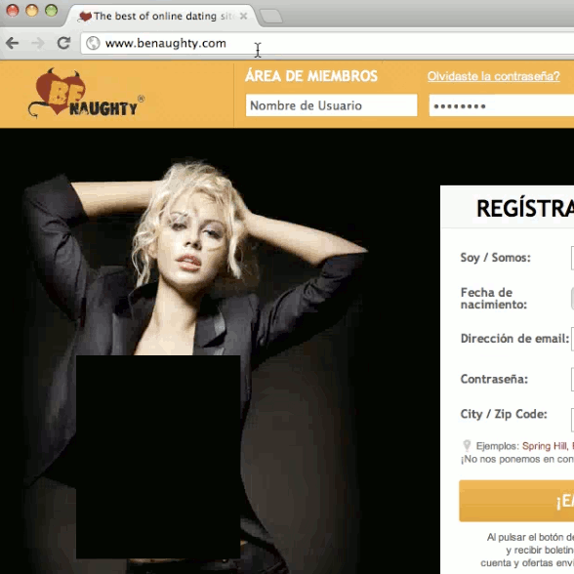
Memprint for Chrome loading benaughty.com
Notes:
Slow down a little bit

Slide 26
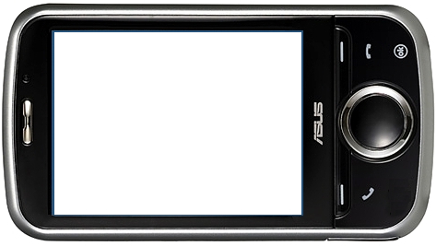
Full attack
zero-permission
app
browser
memprint
/proc/pid/statm
memprint
database
OS isolation
Notes:
I’m illustrating this with a zero-permission process but this attack works just as well in multi-user desktops

Slide 27
Why the attack works
Memprints are unique (for up to 43% of webpages)
Can tune recognition to achieve zero false positives
Memprints are stable
… across repeated visits to the same page
memprints are
OS/browser-dependent but
machine-independent
Notes:
Audio: say that “false positives are calculated for both stable/unstable pages……..the same version of browser + OS given a particular website will have similar memprints even while running on on different hardware configs

Slide 28
Cross-page similarity for 100 random pages out of Alexa top 1000
similarity = Jaccard index of memprints
web page ID
Similar to
themselves
web page ID
Different from others

Slide 29
Fine-grained info leak: OkCupid
is login successful?
no
memory usage increases by
1-2 MB
memory usage increases by
27-36 MB
yes
yes
is a paid
customer ?
no
new flash player plugin process to display ads
no new flash player plugin process
Notes:
This is just an example of a leak…we have other examples in the paper

Slide 30
Concurrent processes don't hurt, sometimes make it even better!!
Notes:
Say that “you might think that we can solve the problem by preventing memory usage sharing” . So let’s see what else can you get without memory usage info.

Slide 31
Memento attacks: CPU usage info
Monitor /proc/<pid>/status for number of context switches
Infer inter-keystroke timing for bash, ssh, Android on-screen keyboard handler etc.
Processing each keystroke requires a predictable number of context switches
Keystroke processing time << keystroke interval
sufficient to
reconstruct typed text
[Zhang and Wang]

Slide 32
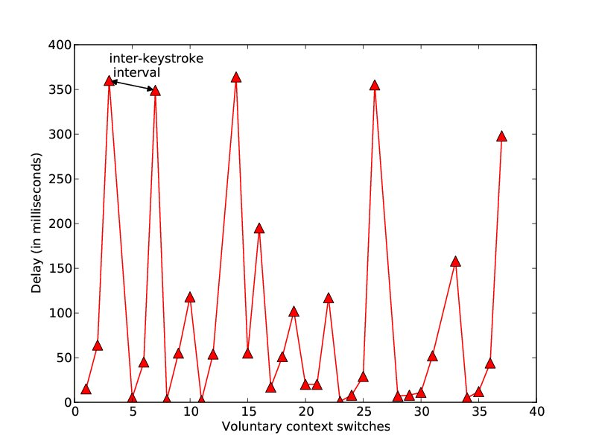
Keystroke timing (Android MMS app)

Slide 33
Solutions?
Increasing reliance on OS isolation makes these attacks easier
OS problem, not an application problem
Disable /proc
FreeBSD: no /proc, but attacker can still measure victim's memory footprint via kvm_getprocs
Stop reporting fine-grained resource usage across “user” boundary
Only report info for user's own processes
Breaks tools like ps, top etc.

Slide 34
Summary
Process info API
A legacy of the 1980s
Reveals process's resource usage - CPU, mem, netw
A single measurement is harmless (most of the time)
Dynamics of processes’ resource usage =
high-bandwidth side channel
Memento attacks
OS designers must rethink
process info API
needed
the API
does NOT need the API

